Slide 1
Chapter 8
Digital Filter Structures

Slide 2
Main Contents in this chapter
1
Block Diagram Representation of the LTI Digital Filter
2
Basic FIR Filter Structure
3
Basic IIR Filter Structure

Slide 3
Block Diagram Representation of Digital Filter
Basic Building Blocks
Delay-Free Loop Problem
Canonic & Equivalent Structure
Mooc 内容

Slide 4
Introduction
The actual implementation of an LTI digital filter could be either in software or hardware form, depending on applications.
The structural representation provides the relations between some pertinent internal variables with the input and the output that in turn provide the keys to the implementation.
In this lecture, we will focus on the block diagram representation of FIR and IIR digital filters
Mooc 内容

Slide 5
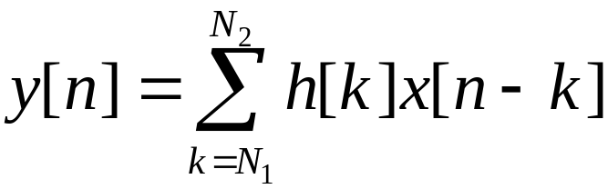
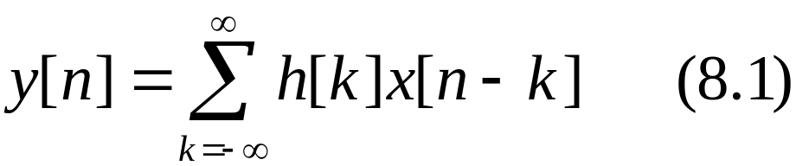
Introduction
But, how can we realize those filters?
For a LTI FIR system we know
For a LTI IIR system

Slide 6
Digital filter Structures
The convolution sum description of an LTI discrete-time system can, in principle, be used to implement the system
For an IIR finite-dimensional system this approach is not practical as here the impulse response is of infinite length
However, a direct implementation of the FIR finite-dimensional
system is practical

Slide 7
Introduction
The above representations are not clear enough for us to implement those filters(such as in hardware form or improving our algorithms).
The structural representation provides the relations between some pertinent internal variables with the input and the output that in turn provide the keys to the implementation.

Slide 8
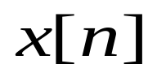
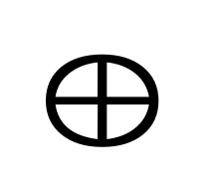

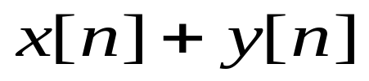

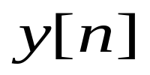


Basic Building Blocks
The basic building blocks and signal-flowing diagram
adder
multiplier
pick-off node
Mooc 内容

Slide 9
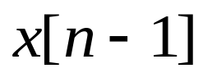



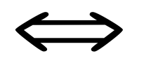
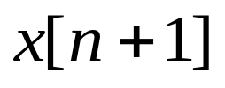





Basic Building Blocks
unit delay
unit advance
modulator
Mooc 内容

Slide 10
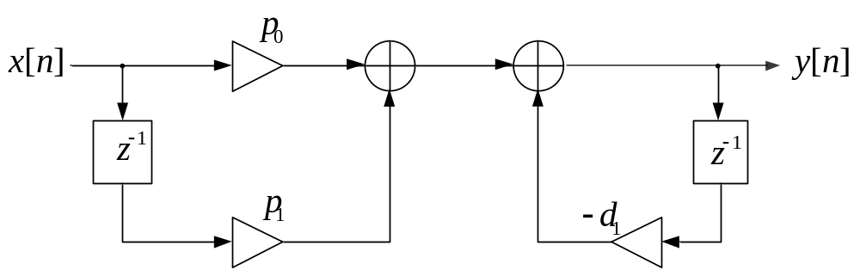
Basic Building Blocks
Example:
Its block diagram is as below:
Mooc 内容

Slide 11
Block Diagram Representation
The advantages of block diagram representation:
Easy to write down the computational algorithm
Easy to determination the relation between the input and output
Easy to derive other “equivalent” block diagram yielding different algorithms
Easy to determine the hardware requirements
Mooc 内容

Slide 12
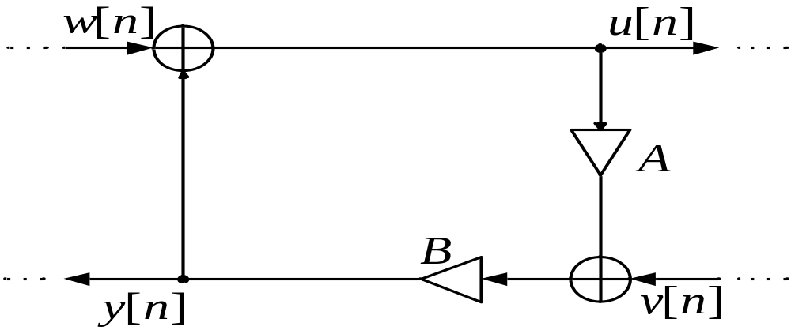
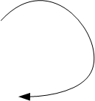
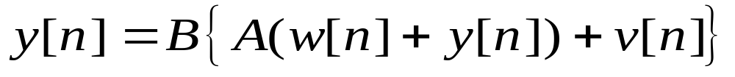
Delay-Free Loop
The Delay-Free Loop Problem
Output y[n] depends on y[n] itself. Physically impossible !
Mooc 内容

Slide 13
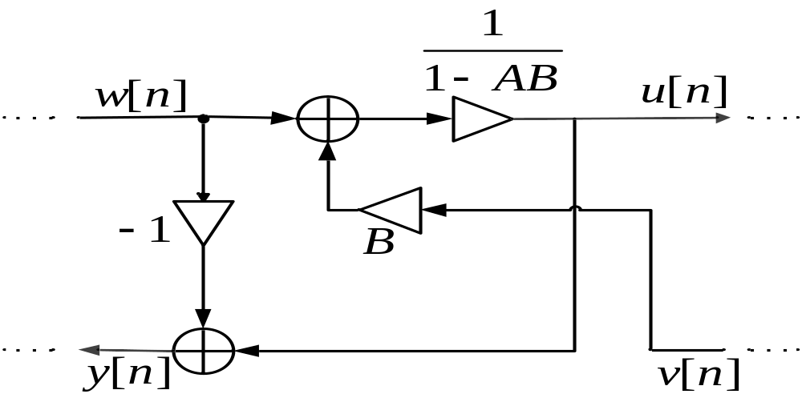
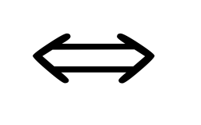
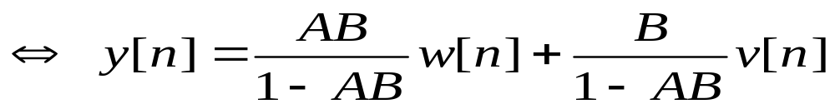
Delay-Free Loop
The Delay-Free Loop Problem
Delay-free loop
No delay-free loop
Mooc 内容

Slide 14
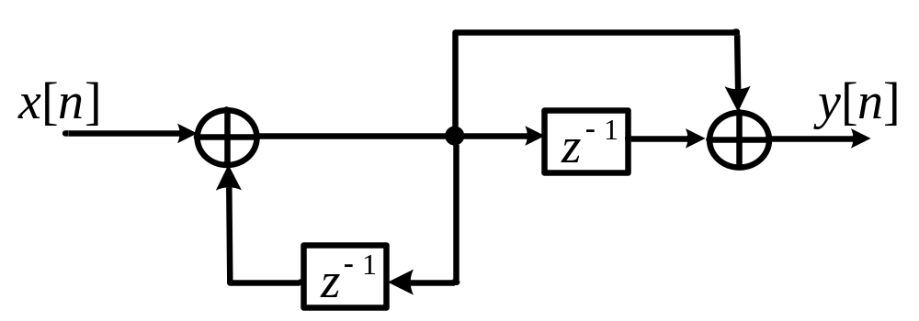
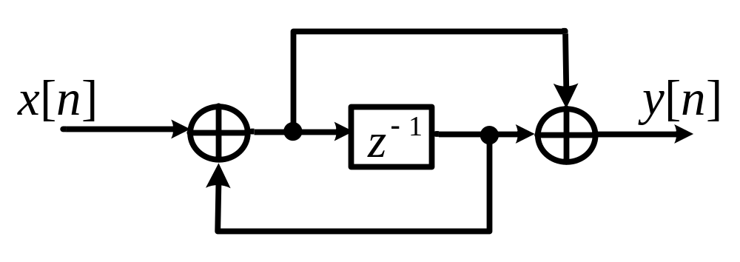
Canonic & Equivalent Structure
Canonic structure
  The number of delays = the order of the difference equation
Example
Non-canonic structure
Canonic structure
Mooc 内容

Slide 15
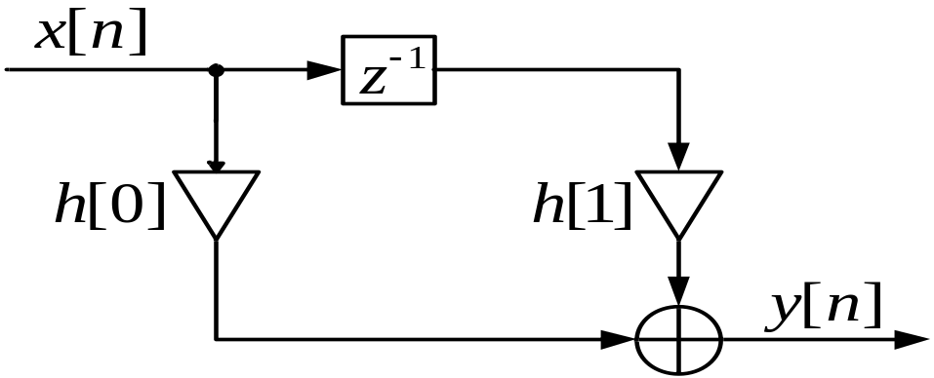
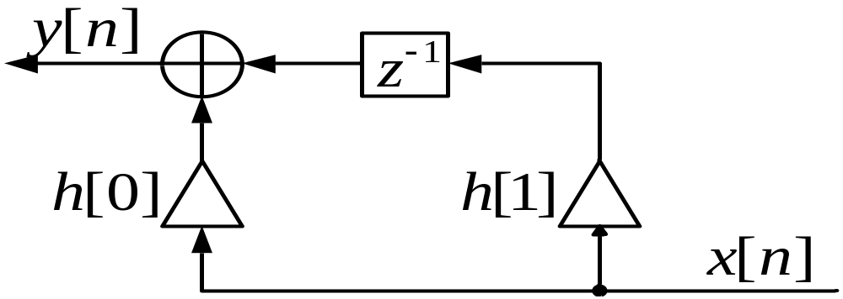
Canonic & Equivalent Structure
Equivalent structure via transpose operation
(1) Reverse all paths
(2) Replace pick-off nodes by adders, and vice versa
(3) Interchange the input and the output nodes
Mooc 内容

Slide 16
Basic FIR & IIR Digital Filter Structure
FIR Filter Structure
IIR Filter Structure
Mooc 内容

Slide 17
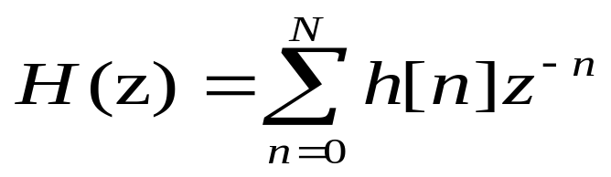
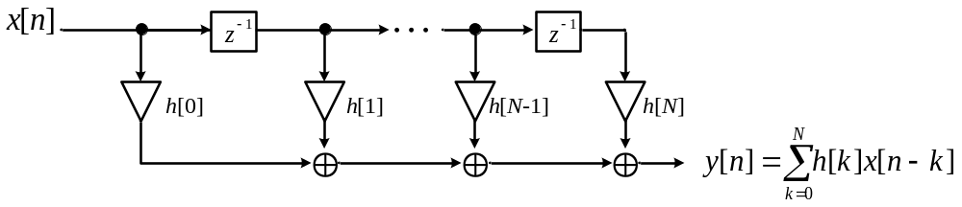
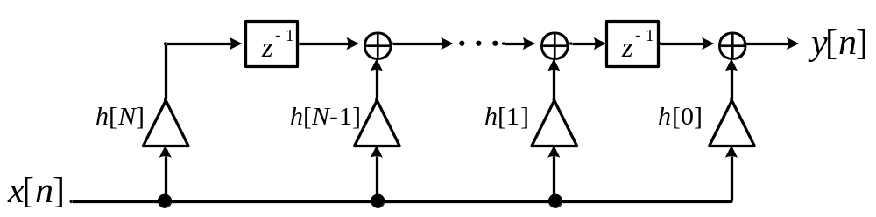

Basic FIR Filter Structure
Direct Form
A causal FIR filter of order N
and its transpose
Direct form is canonic structure
Mooc 内容

Slide 18
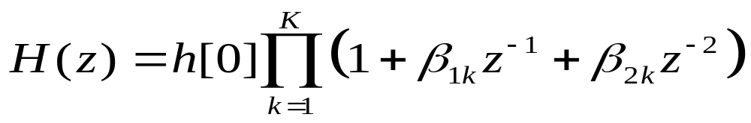
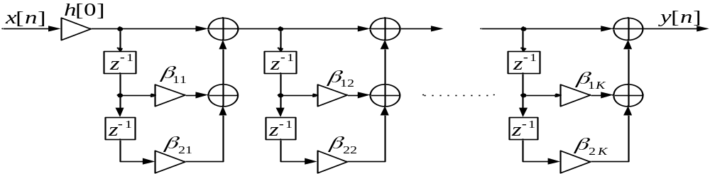
Basic FIR Filter Structure
Cascade Form
where H(z) is divided into 1st-order (i.e., β_{2k} =0) or 2nd-order (i.e., β_{2k} ≠0) transfer functions.
Cascade form is also canonic structure
Mooc 内容

Slide 19
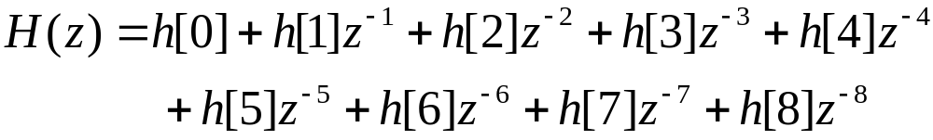
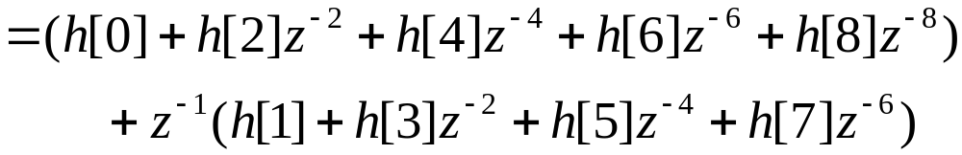


8.3 Basic FIR Filter Structure
8.3.3 Polyphase realization
See Fig8.7c
See Fig8.7b
See Fig8.7a
(掌握)

Slide 20
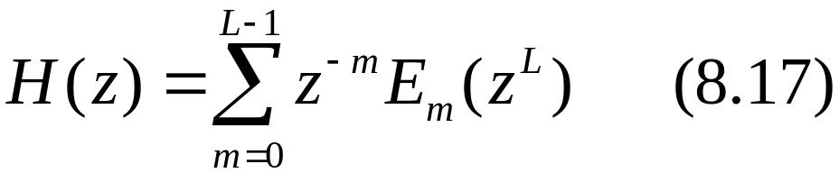
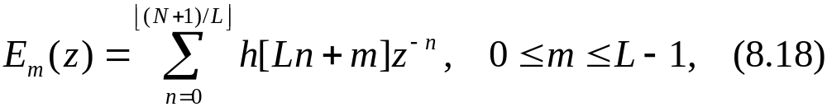
8.3 Basic FIR Filter Structure
The above structures are noncanonic. For
Where
If the delay(z^{-L}) in all subfilters are shared, the structure is canonic. See Fig8.8
The polyphase structures are often used in multirate digital signal processing applications for computation efficient realizations.
(掌握)

Slide 21
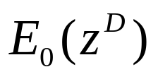

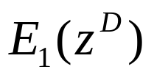
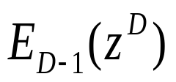
Application:
x[n]
y[n]
D
Polyphase Realization (decimation)
…
………

Slide 22
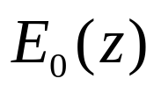


Application:
x[n]
y[n]
D
D
………
…
D

Slide 23
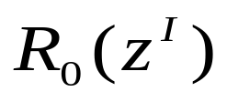
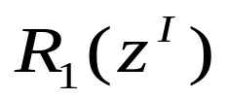
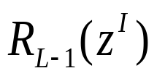
Application:
x[n]
I
Polyphase Realization (interpolation)
………
…
y[n]

Slide 24
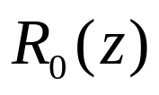


Application:
x[n]
I
I
………
…
y[n]
I

Slide 25
8.3 Basic FIR Filter Structure
8.3.4 Linear-Phase FIR Structures
Linear-Phase FIR filter : h[n] is symmetric, or antisymmetric:
The characterization can reduce the number of multipliers (almost a half) indirect form.
Example
The implementations of length 7 and 8 with symmetric impulse response :
(掌握)

Slide 26
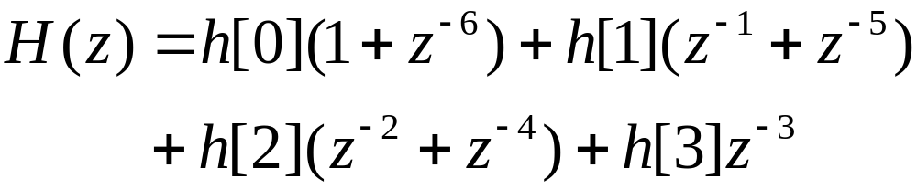
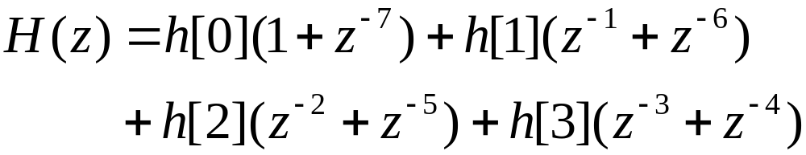
8.3 Basic FIR Filter Structure
It is noted that a similar savings occurs in the case of an FIR filter with an antisymmetric impulse response.
(掌握)

Slide 27
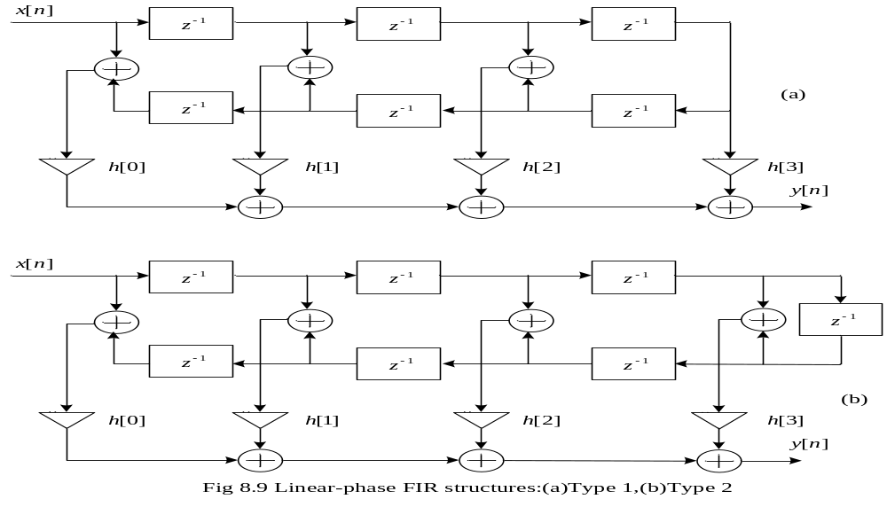
8.3 Basic FIR Filter Structure
(掌握)

Slide 28
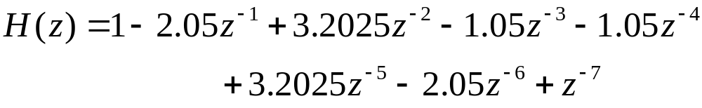

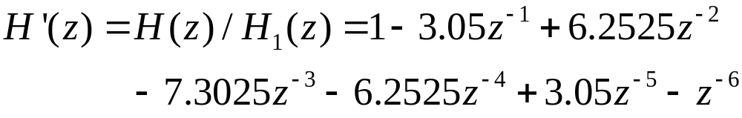
8.3 Basic FIR Filter Structure
Example: Given an FIR filter as below
Its cascade form structure is wanted.
Solution:
(掌握)

Slide 29
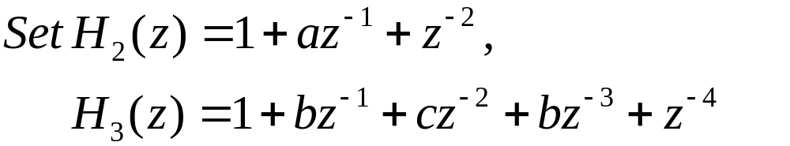

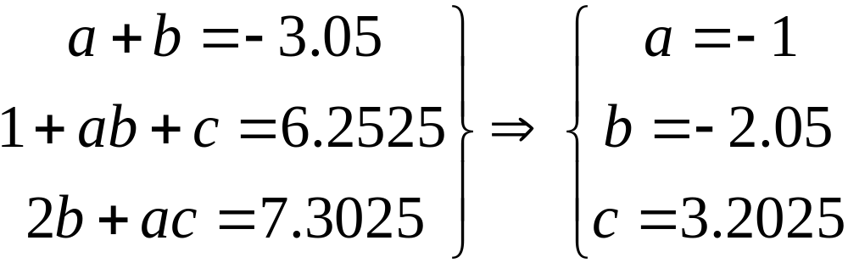
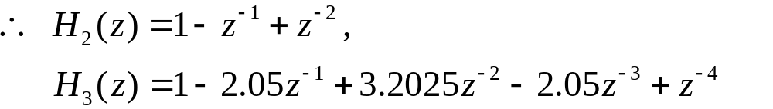
8.3 Basic FIR Filter Structure
(掌握)

Slide 30
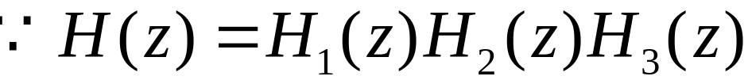

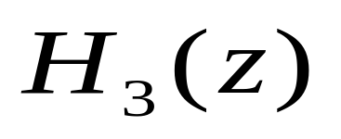

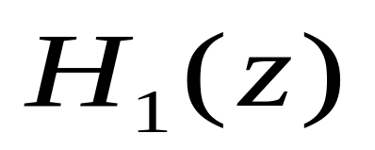
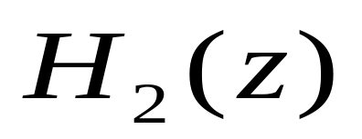


8.3 Basic FIR Filter Structure
Its cascade form structure is as below:
(掌握)

Slide 31
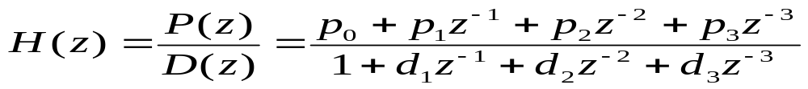



Basic IIR Filter Structure
Direct Form
A possible realization scheme
Mooc 内容

Slide 32





Basic IIR Filter Structure
Mooc 内容

Slide 33




H(z)=H₁(z)H₂(z)
Transpose
H(z)=H₂(z)H₁(z)
Transpose
Mooc 内容

Slide 34


canonic structure
H(z)=H₂(z)H₁(z)
Transpose
Mooc 内容

Slide 35

Basic IIR Filter Structure
Cascade Form
It is easy to modify zeros and poles.
But the forms of realization are no identical.
Mooc 内容

Slide 36

Basic IIR Filter Structure
Parallel Form
It is needed partial-fractional expansion
It is easy to modify poles with identical form
Mooc 内容

Slide 37


Basic IIR Filter Structure
Example: For a system as below
Its transfer function is
Mooc 内容

Slide 38






Basic IIR Filter Structure
Its direct form
The cascade form with 1st order
The parallel form with first-order
Mooc 内容

Slide 39









8.4 Basic IIR Structure
Example For a system as below
Its direct form is as below
(掌握)

Slide 40









8.4 Basic IIR Structure
Its cascade form with second-order
(掌握)

Slide 41




8.4 Basic IIR Structure
Its paralle form with second-order
(掌握)

Slide 42
8.5 Realization Using MATLAB
The cascade form requires the factorization of the transfer function which can be developed using the M-file zp2sos
The statement sos = zp2sos(z,p,k) generates a matrix sos containing the coefficients of each 2nd-order section of the equivalent transfer function H(z) determined from its pole-zero form
自学内容

Slide 43
Homework
Problems
8.5, 8.11, 8.13, 8.25,8.28
M8.1, M8.2, M8.3

